Slide 1
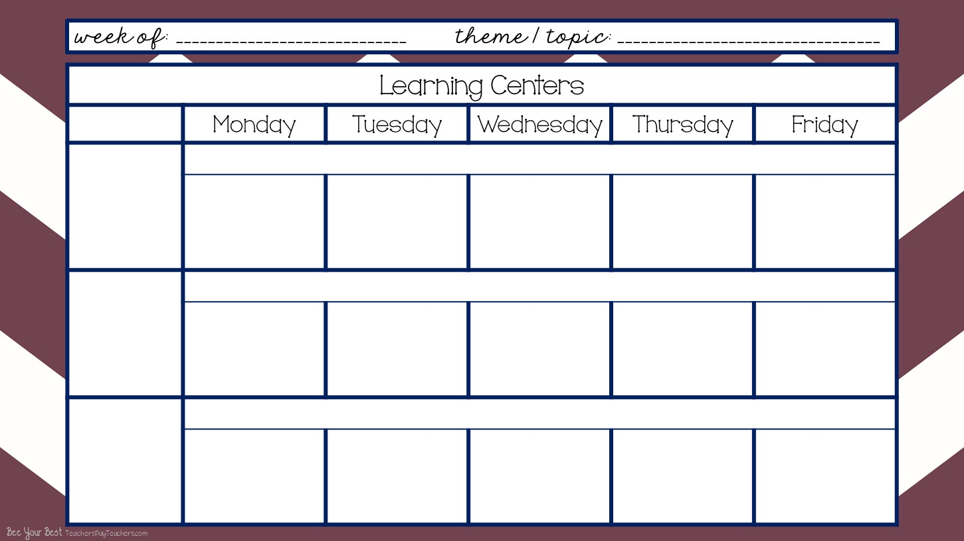
Wk# 1 -- Aug. 24-28,2020
Chicka Chicka Boom Boom / All About Me
Arrival & Free Play
8:40-9:40
I can become more independent. I can recognize and find my name and cubby. I can put my stuff away. I can choose an activity and friends to play with.
FOCUS - ABCs,Red, Circle
Fine Motor Skills practice line tracing from letters to Chicka Chicka Boom Boom Trees
Color Sheet Chicka Chicka Boom Boom Tree
Water Color - My Favorite Color is paper
Color Owl in Glasses Picture
Potato Head Color Sheet
Clean Up
9:40-9:45
I can work with my friends and clean up and put things away then come to the carpet and get ready to learn altogether.
Community Carpet Time
9:45-10:10
I can sit on my spot on the carpet. I can listen to my teacher. I can keep my hands to myself. I can participate and learn.
Come to the Carpet
Criss Cross Applesauce
Dr. Jean’s Rules Rap
See It, Say It Sign It
Red & Cindy Circle Song
You’re A Grand Old Flag
Criss Cross Applesauce
Dr. Jean’s Rules Rap
See It, Say It, Sign It
Red & Cindy Circle Song
You’re A Grand Old Flag
Oklahoma
Come to the Carpet
Criss Cross Applesauce
Dr. Jean’s Rules Rap
Zoo Phonics with flashcards
Hickory DIckory Dock
Hey DIddle Diddle
Criss Cross Applesauce
Dr. Jean’s Rules Rap
Zoo Phonics with Flash Cards
Red & Cindy Circle Song
You’re a Grand Old Flag
Oklahoma
Come to the Carpet
Criss Cross Applesauce
Dr. Jean’s Rules Rap
Go Letters Dr. Jean
Singing Walrus Shapes Song
Counting Crayons & Colors

Slide 2
Wk# 2-- August 24-28 , 2020
Chicka Chicka Boom Boom / All About Me
Morning Recess
10:10-10:40
I can play with my friends and share the equipment. I can play on the equipment correctly. I can line up when it’s time to go in.
Outside on Playground
(if there’s inclement weather then do rainy day boxes inside the classroom)
Mini Lessons
10:40-10:55
I can listen, learn, and participate in mini literacy, math, social skills, science, and social studies lessons.
Mini Literacy Lesson
Read Aloud
Class Discussion
Mini Math Lesson
Mini Literacy Lesson
Name of the Day
Mini Social Skills Lesson + Class Discussion / Anchor Chart
Mini Science / Social Studies Lesson -- use Weekly Reader + Class Discussion
Lunch
11:00-11:30 Afternoon Recess
11:30-noon
I can eat lunch and clean up my mess when I’m done. I can line up and walk to and from lunch and recess. I can keep my hands to myself and be nice to my neighbors.
Cafeteria & Outside on Playground
(if there’s inclement weather then do rainy day boxes inside the classroom)

Slide 3
Wk# 2 -- August 24-28, 2020
...
Chicka Chicka Boom Boom / All About Me
Smart Board Activity
noon-12:45
I can enjoy engaging Smart Board Activities while cooling down or warming up from being at recess. I will go to the bathroom and wash my hands. I will participate in smart board activities.
Color & Shape Monster Game
Smart Board / Brain Breaks
Who Took the Cookies from the Cookie Jar?
The Numeral Song with “air writers”
Who Took the Cookies from the Cookie Jar Name Activity
Work Stations / Center Rotations with Buddy
12:15-1:15
I can work with my work station buddy. I can share and communicate. I can clean up. I can put my papers away. I can learn the chart and move around. I can follow instructions. I can learn and grow!
Library -2- Thematic Unit Books
Shannon -4- Monday - Color By # Chicka Chicka
Tuesday - Chicka Chicka Boom Boom Tree All About Me
NO Work Stations because it’s Early Out Day
Library -2- Thematic Unit Books
Shannon -4- Thursday Pasting & Coloring Birthday Cake Paper
Friday - All About Me Hat
Work Stations cont’d.
Math -2- Chicka Chicka Boom Boom # Cards and matching # tiles to cards and tubs
Literacy -2- Match the magnetic letters to the chicka chicka boom boom alphabet trays
NO Work Stations because it’s Early Out Day
Math -2- Trace and / Stamp #s
Literacy -2- Pick a card and trace the ABCs

Slide 4
Wk# -2 - August 24-28,2020
...
Chicka Chicka Boom Boom / All About Me
Work Stations cont’d.
Home & Living -4- Play & Pretend
Blocks -2- Build & Create
Magnets - 2 Play with Turn & Learn Gears
NO Work Stations because it’s Early Out Day
Home & Living -4- Play & Pretend
Blocks -2- Build & Create
Magnets - 2 Play with Turn & Learn Gears
.
I can eat and drink at snack time. I can wash up before and after snack. I can toss my trash.
Afternoon Snack
1:15-1:30
Wash Up -- Eat & Drink -- Clean Up & Toss Trash
Extra! Extra!
1:30 - 2:15
BIG GROUP -- Name of the Day
Weekly Reader
Art Hub for Kids guided art lesson
Journals
White Boards

Slide 5
Wk# -2 August 24-28, 2020
Chicka Chicka Boom Boom / All About Me
Pack Up & Get Ready to Go Home Daily Review
2:15-2:20
I can pack up my backpack and put on my jacket. I can sit on my square on the carpet and be kind to my neighbors. I can listen and learn.
Dismissal
2:20-2:30
I can line up and follow instructions of where to go and what to do from my teachers. I can be happy to go home!
Teacher Planning
2:30-3:40
I can plan awesome opportunities to learn and grow and be flexible as changes inevitably come.
PK
Grade Level
Mtg.

